Slide 1
Usable Security Policies + User Training: The Best Method to Counter Social Engineering Attacks
TUTORIAL
Rebecca Long
Eastern Washington University
Cheney, Washington USA

Slide 2
Overview
Introduction
Problem
Background
Definition of social engineering
Social engineering cycle
Solutions
Security Policies
User Training
Counter-Measures
Summary

Slide 3
Introduction

Slide 4
Secure-System
A secure system…
Part of wider socio-technical system
Includes both human and technical components
Fully secure system is ultimate goal
Must protect system, private data, physical campus where system is located
Use many methods to protect and secure system
Security technology
Security policies
User training

Slide 5
Problem
Hackers will always find the easiest way to break into a system
Users are the weakest part of a secure-system
Human-Factor of Security
Easily exploited and constantly overlooked
Often responsible for failure of security systems
Social Engineering is a serious problem to any secure-system
Directly takes advantage of system users and the human-element

Slide 6
Background

Slide 7
Definition
Social engineering:
“… exploitation of psychological triggers and cognitive biases as a means to gain unauthorized access to information or information systems”
“… the art and science of getting people to comply with your wishes”
“… uses influence and persuasion to deceive people … to take advantage of people to obtain information with or without the use of technology”
Social engineers use tricks and manipulation to gain trust of system users

Slide 8
Social Engineering Cycle
Typical cycle used by a social engineer:
Information Gathering
Developing Relationships
Exploitation
Execution

Slide 9
Information Gathering
Social engineer performs background research to learn about attack target
Makes it easier to trick users
Techniques Used to Gather Information
Asking for favors | Photography
Cold calling | Phishing
Contriving situations | Reverse social engineering
Dumpster diving | Simple requests
Forensic analysis | Shoulder surfing
Giving out free software | Theft
Impersonation | Trojans

Slide 10
Developing Relationships
Once enough information has been gathered, the social engineer can develop relationships with key users
Builds trust with user
To be exploited in next step

Slide 11
Exploitation
Once the trust between the social engineer and a user has been established, the social engineer will exploit the new relationship
Gain further information
Have the user perform an act to help the social engineer carry out their attack
Example:
Ask for remote access from user (dial-up, VPN, etc.)
Have user install a Trojan on a system computer

Slide 12
Execution
This stage of the cycle the social engineer finishes their attack
Example:
Remote in to system with access gained in previous step and perform whatever attack you wish
Use installed Trojan to gain access to critical system files and data

Slide 13
How to Address Social Engineering Problem

Slide 14

Secure Whole System
Secure system via multiple methods
Technological security
Physical security
Security policies
User training
Security policies work to regulate the system and users of system
How to use security technology
Minimize risk of social engineering attacks
User training
Explanation of security policies
Give understanding of importance
How to recognize a social engineering attack

Slide 15
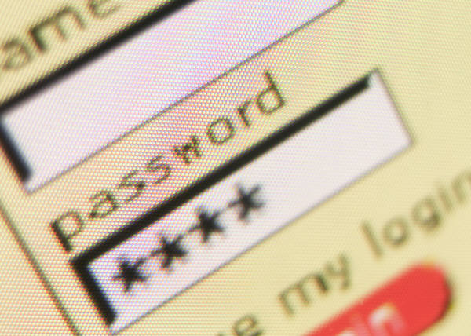
Security Policies
Security policies must be user-friendly, otherwise:
Users will not know how to follow
Users will have a difficult time trying to follow
Users may decide against following a policy if it seems to unreasonable

Slide 16
Security Policies
Policies must cover:
The technology used in the secure-system
How to properly dispose of documents
How to handle email and phone calls
What information can be given to public
Who is allowed on work campus

Slide 17
Security Policies
Policies must directly address social engineering
Give users procedures and directions on what to do in case of a social engineering attack
Have policies in place to help minimize the risk of an attack:
Explanation of what information is confidential and what is public
Users cannot give out confidential information
PIN setup for each user to use with Help Desk

Slide 18
User Training
Training on security policies:
What the security policies are
How to correctly follow the policies
Training must explain importance of policies
Users who understand purpose of policies are more likely to follow them
Training should motivate users to actively participate in security
Explain it is not just the IT Department or the security guards responsibility to help protect system

Slide 19
User Training
Extra training needs to be given to users specifically on social engineering
Explain what social engineering is
How social engineering attacks are carried out
Give examples of social engineering attacks and possible techniques
Explain which security policies help minimize a social engineering attack
How to recognize an attack
What to do if one happens

Slide 20
Social Engineering Counter-Measures

Slide 21
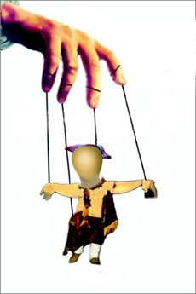
Preventing Social Engineering
While there is no way to 100% prevent a social engineering attack
The following tactics should be considered when creating security policies and user training on social engineering
Taken from Sarah Granger, SecurityFocus

Slide 22
Counter-Measure Tactics
Area of Risk | Tactic | Counter-Measure
Building entrance | Unauthorized physical access | Tight badge security, employee training, and security officers present
Dumpsters | Dumpster diving | Keep all trash in secured, monitored areas, shred important data, erase magnetic media
General Psychological | Impersonation & persuasion | Give users continual awareness and training

Slide 23
Counter-Measure Tactics
Area of Risk | Tactic | Counter-Measure
Intranet and Internet | Creation & insertion of mock software on intranet and Internet to steal passwords | Continual awareness of system and network change, training on password use
Machine Room and Phone Closet | Attempt to gain access, remove equipment, attach a protocol analyzer to grab confidential data | Keep phone closets, server rooms, etc. locked at all times and keep updated inventory on equipment
Mail Room | Insertion of forged documents | Lock and monitor mail room
Office | Shoulder surfing | Don’t type passwords with anyone present

Slide 24
Counter-Measure Tactics
Area of Risk | Tactic | Counter-Measure
Office | Wandering halls looking for open offices | Require all guests to be escorted
Phone and PBX | Stealing phone toll access | Control overseas and long-distance calls, refuse transfers
Phone (Help Desk) | Impersonation and persuasion | Train employees / help desk to never give out passwords or other confidential info by phone
Phone (Help Desk) | Impersonation on help desk calls | All employees should be assigned a PIN specific to help desk support

Slide 25
Summary
Social and technological factors must be addressed when creating a secure-system
Human-element of security is weakest link of any secure-system
Makes it vulnerable to social engineering attacks
Specific security policies and user training must address human-element and social engineering
Must be user friendly
Must motivate users to follow policies
Must teach users why they are important

Slide 26
Thank you 有難うございます Questions?

